Slide 1
Шарик
Разработчик Лысенко Даниил

Slide 2

Структура
В игре есть 3 класса и 2 уровня (они были оформлены в виде функции)

Slide 3
class Target (класс мишени)
class Target(pygame.sprite.Sprite): FRAMES = ["data/sprites/target_0.png", "data/sprites/target_1.png"] def __init__(self, pos, tile_size_, gr, speed, player): super().__init__(gr) self.size = tile_size_ self.image = pygame.image.load(Target.FRAMES[0]).convert_alpha() self.image = pygame.transform.scale(self.image, (self.size, self.size)) self.pos = pos self.rect = self.image.get_rect() self.frame = 0 self.move = 0 self.speed = speed if player.score >= 10: self.move = random.choice([1, -1]) self.speed = player.score / 10 def update(self, frame_speed_, screen_, screen_cap_, tile_size_, player, player_sprites_): self.frame += 1 * frame_speed_ if self.frame < 0.5: self.image = pygame.image.load(Target.FRAMES[0]).convert_alpha() elif self.frame > 1: self.frame = 0 elif self.frame > 0.5: self.image = pygame.image.load(Target.FRAMES[1]).convert_alpha() if self.rect.colliderect(player.rect): self.pos[1] = random.choice(range(1, 10)) player.score += 1 player.balls += 1 if player.score >= 10: self.move = random.choice([1, -1]) self.speed = player.score / 10 if self.pos[1] > 9: self.pos[1] = 9 self.move = -1 elif self.pos[1] < 1: self.pos[1] = 1 self.move = 1 self.pos[1] += self.speed * self.move * frame_speed_ self.image = pygame.transform.scale(self.image, (self.size, self.size)) self.rect.center = (screen_cap_[0] + self.pos[0] * tile_size_, screen_cap_[1] + self.pos[1] * tile_size_)

Slide 4
class Ball (класс игрока)
if keys_[pygame.K_UP]: self.start_speed[1] += 10 * frame_speed_ if keys_[pygame.K_DOWN]: self.start_speed[1] -= 10 * frame_speed_ if keys_[pygame.K_LEFT]: self.start_speed[0] -= 10 * frame_speed_ if keys_[pygame.K_RIGHT]: self.start_speed[0] += 10 * frame_speed_ if self.start_speed[0] > 7: self.start_speed[0] = 7 elif self.start_speed[0] < 0: self.start_speed[0] = 0 if self.start_speed[1] > 20: self.start_speed[1] = 20 elif self.start_speed[1] < -10: self.start_speed[1] = -10 speed = self.start_speed[1] for i in range(1, 5): speed -= self.start_a[1] * 0.05 tr_pos = (screen_cap_[0] + tile_size_ * (self.pos[0] + self.start_speed[0] * 0.1 * i), screen_cap_[1] + tile_size_ * (self.pos[1] - speed * 0.1 * i)) pygame.draw.circle(screen_, (128, 128, 128), tr_pos, tile_size_ * 0.1, 0) else: if self.start_speed[1] is not None and self.start_speed[0] is not None: self.speed[1] = self.start_speed[1] self.speed[0] = self.start_speed[0] self.start_speed[1] = None self.start_speed[0] = None self.speed[1] -= self.start_a[1] * frame_speed_ self.pos[0] += self.speed[0] * frame_speed_ self.pos[1] -= self.speed[1] * frame_speed_ if self.pos[0] > 15 or self.pos[1] > 15 or self.pos[0] < -5 or self.pos[1] < -5: self.__init__([1, 5], [1, 9.8], self.gr, self.score, self.balls - 1, tile_size_, self.skin) self.rect.center = ((screen_cap_[0] + tile_size_ * self.pos[0]), screen_cap_[1] + tile_size_ * self.pos[1])
lass Ball(pygame.sprite.Sprite): SKINS = ["data/sprites/player_0.png", "data/sprites/player_1.png", "data/sprites/player_2.png", "data/sprites/player_3.png", "data/sprites/player_4.png"] def __init__(self, pos, speed, gr, score_, balls_, tile_size_, skin): super().__init__(gr) self.score = score_ self.skin = skin self.image = pygame.image.load(Ball.SKINS[self.skin]).convert_alpha() self.image = pygame.transform.scale(self.image, (tile_size_, tile_size_)) self.rect = self.image.get_rect() self.pos = pos self.start_speed = speed self.speed = [0, 0] self.start_a = [0, 9.8] self.shooted = False self.balls = balls_ self.gr = gr def update(self, events, keys_, frame_speed_, screen_, screen_cap_, tile_size_): for event in events: if event.type == pygame.KEYDOWN and event.key == pygame.K_EQUALS: self.skin += 1 if self.skin > 4: self.skin = 4 self.image = pygame.image.load(Ball.SKINS[self.skin]).convert_alpha() self.image = pygame.transform.scale(self.image, (tile_size_, tile_size_)) self.rect = self.image.get_rect() elif event.type == pygame.KEYDOWN and event.key == pygame.K_MINUS: self.skin -= 1 if self.skin < 0: self.skin = 0 self.image = pygame.image.load(Ball.SKINS[self.skin]).convert_alpha() self.image = pygame.transform.scale(self.image, (tile_size_, tile_size_)) self.rect = self.image.get_rect() if not self.shooted: if keys_[pygame.K_SPACE]: self.shooted = True

Slide 5
class InputBox (класс поля ввода)
class InputBox: COLOR_INACTIVE = (0, 128, 0) COLOR_ACTIVE = (0, 255, 0) FONT = pygame.font.Font("data/font/Undertale-Battle-Font.ttf", 35) def __init__(self, x, y, w, h, text=''): self.rect = pygame.Rect(x, y, w, h) self.color = InputBox.COLOR_INACTIVE self.text = text self.txt_surface = InputBox.FONT.render(text, True, self.color) self.active = False def handle_event(self, event): if event.type == pygame.MOUSEBUTTONDOWN: if self.rect.collidepoint(event.pos): self.active = not self.active else: self.active = False self.color = InputBox.COLOR_ACTIVE if self.active else InputBox.COLOR_INACTIVE if event.type == pygame.KEYDOWN: if self.active: if event.key == pygame.K_RETURN: print(self.text) self.text = '' elif event.key == pygame.K_BACKSPACE: self.text = self.text[:-1] else: self.text += event.unicode self.txt_surface = InputBox.FONT.render(self.text, True, self.color) def update(self): width = max(200, self.txt_surface.get_width()+10) self.rect.w = width def draw(self, screen): screen.blit(self.txt_surface, (self.rect.x+5, self.rect.y+5)) pygame.draw.rect(screen, self.color, self.rect, 2)

Slide 6
start_screen (функция стартового экрана)
def start_screen(): config_file = open("data/config.txt", "r", encoding="utf-8").readlines() screen = pygame.display.set_mode(eval(config_file[0])) pygame.display.set_caption("Не придумаль :(") screen_size = screen.get_size() pygame.mouse.set_visible(False) cursor_im = pygame.transform.scale(pygame.image.load("data/sprites/cursor_0.png").convert_alpha(), (64, 64)) user_name = InputBox(0, 0, 500, 50, "User_Name") c_pos = (0, 0) button = Button( screen, 100, 100, 300, 150, text='Играть', fontSize=50, margin=20, inactiveColour=(0, 128, 0), pressedColour=(0, 255, 0), radius=20, onClick=lambda: main(screen, user_name.text, cursor_im) ) running = True while running: events = pygame.event.get() keys = pygame.key.get_pressed() for event in events: if event.type == pygame.QUIT or (event.type == pygame.KEYDOWN and event.key == pygame.K_ESCAPE): running = False elif event.type == pygame.KEYDOWN and event.key == pygame.K_RETURN: main(screen, user_name.text, cursor_im) if event.type == pygame.MOUSEMOTION: c_pos = event.pos user_name.handle_event(event) user_name.update() user_name.rect.center = (screen_size[0] / 2, screen_size[1] / 2) button.setX(screen_size[0] / 2 - button.getWidth() / 2) button.setY(screen_size[1] / 2 - button.getHeight() / 2 + 150) screen.fill((0, 0, 0)) pygame_widgets.update(events) user_name.draw(screen) screen.blit(cursor_im, c_pos) pygame.display.flip() pygame.quit()

Slide 7
main (функция собственно самой игры)
def main(screen, name, cursor): c_pos = (0, 0) try: save_file = open(f"saves/{name}_sav.txt", "r", encoding="utf-8").readlines() except Exception as error: print(error) if not os.path.exists("saves"): os.mkdir("saves") save_file = None screen_size = screen.get_size() player_sprites = pygame.sprite.Group() target_sprites = pygame.sprite.Group() tile_size = min(screen_size) / 10 screen_cap_x = (screen_size[0] - tile_size * 10) / 2 screen_cap_y = (screen_size[1] - tile_size * 10) / 2 screen_cap = screen_cap_x, screen_cap_y if save_file is None: ball = Ball([1, 5], [1, 9.8], player_sprites, 0, 10, tile_size, 0) else: ball = Ball([1, 5], [1, 9.8], player_sprites, int(save_file[0]), int(save_file[1]), tile_size, int(save_file[2])) target = Target([9, 5], tile_size, target_sprites, 1, ball) clock = pygame.time.Clock() font = pygame.font.Font("data/font/Undertale-Battle-Font.ttf", 35) bg = pygame.image.load("data/sprites/BG.png") bg = pygame.transform.scale(bg, (min(screen_size), min(screen_size))) bg1 = pygame.image.load("data/sprites/BG_1.png") bg1 = pygame.transform.scale(bg1, (min(screen_size), min(screen_size))) exiting = False running = True game_over = False while running: frame_speed = clock.tick() / 1000 events = pygame.event.get() keys = pygame.key.get_pressed() for event in events: if event.type == pygame.QUIT: exiting = True running = False if event.type == pygame.MOUSEMOTION: c_pos = event.pos if keys[pygame.K_ESCAPE]: running = False if keys[pygame.K_r]: main(screen, name, cursor) if ball.balls <= 0: game_over = True screen.fill((0, 0, 0))
if not game_over: screen.blit(bg, screen_cap) player_sprites.update(events, keys, frame_speed, screen, screen_cap, tile_size) player_sprites.draw(screen) target_sprites.update(frame_speed, screen, screen_cap, tile_size, ball, player_sprites) target_sprites.draw(screen) score = font.render(f"Очков: {ball.score}", True, (255, 255, 255)) balls = font.render(f"Мячей: {ball.balls}", True, (255, 255, 255)) screen.blit(score, (0, 0)) screen.blit(balls, (0, screen_size[1] - 50)) else: screen.blit(bg1, screen_cap) screen.blit(cursor, c_pos) pygame.display.flip() if not game_over: save_file = open(f"saves/{name}_sav.txt", "w+", encoding="utf-8") save_file.write(f'{ball.score}\n{ball.balls}\n{ball.skin}') if exiting: pygame.quit()

Slide 8
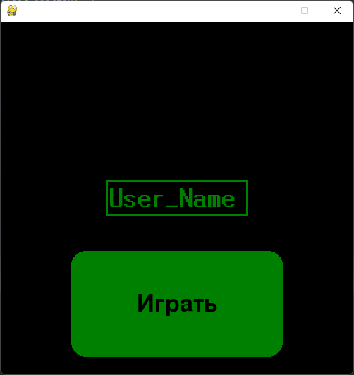
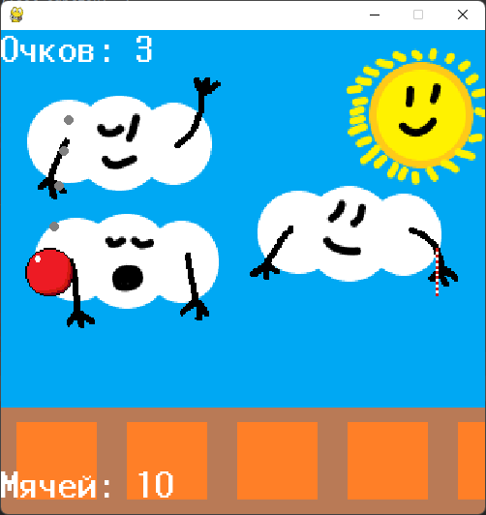
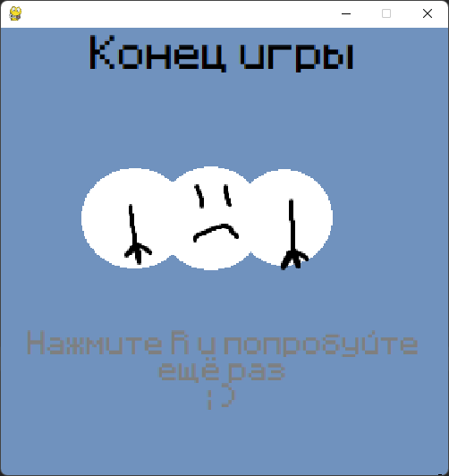
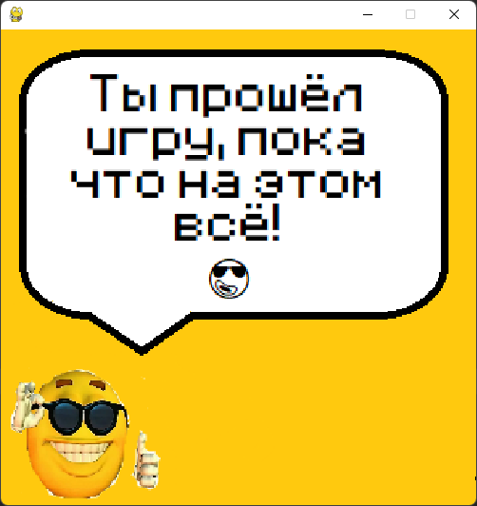
Игра состоит из 4 экранов
Главный экран
Игра
Экран проигрыша
Экран победы

Slide 9

Игровой процесс
У вас есть 150 мячей которыми нужно сбить цель, нужно набрать 100 очков для победы.

Slide 10
Особенности
Есть возможность ввести имя игрока которое будет использовано чтобы сохранять прогресс
По достижению 10 очков, цель начинает двигаться и с каждым попаданием делает это всё быстрее и быстрее.
Можно менять цвет мячика :3

Slide 11
Как играть?
Стрелочками на клавиатуре нужно регулировать начальную скорость шарика.
Если шарик попал в цель то игроку засчитывается 1 очко
Цель набрать 100 очков (и не проиграть (в случае проигрыша данные сохранения стираются))

Slide 12

На этом всё!
Для более подробных сведений читай пояснительную записку

